Slide 1
Praktikum: Cloud Data Bases (IN0012, IN2106, IN4163)
by Aly Kamel, Iremur Kidil, Ricardo Kraft
28.01.2020

Slide 2
Overview
Use Case Scenario
Motivation
First Glance to our Extension – Group Chat
Implementation
Demonstration
Perfomance Tests
Experimental setup
Diagramms
Conclusion
Pros and Cons
Recommendation of the extension
References
Discussion

Slide 3
I. The Use Case Scenario TODO→find a good use case
Client 1
Client 2
DATA BASE
„Clients want to communicate with each other about the data,
while not having to use 3rd party software“

Slide 4
II. Motivation TODO → should be about Redis Pub/Sub
Our solution: The Chatroom
Bot: Ricardo has joined the chat.
Ricardo: Hey guys, what‘s up?
Aly: Hi hi, everything‘s fine here!
Irem: Helloooo, ... nothing, just working.
Ricardo: Nice, btw. Where can I find ... ?
Aly: You have to check the keys ...
Irem: And if its not there, check ...
Ricardo: Thx a lot :)!!!

Slide 5
III. First Glance to our Extension – Group Chat I. Functionalities
Unique Username
“chat” Command
Private/Public Chatrooms
Password
Saved Messages
ChatBot

Slide 6
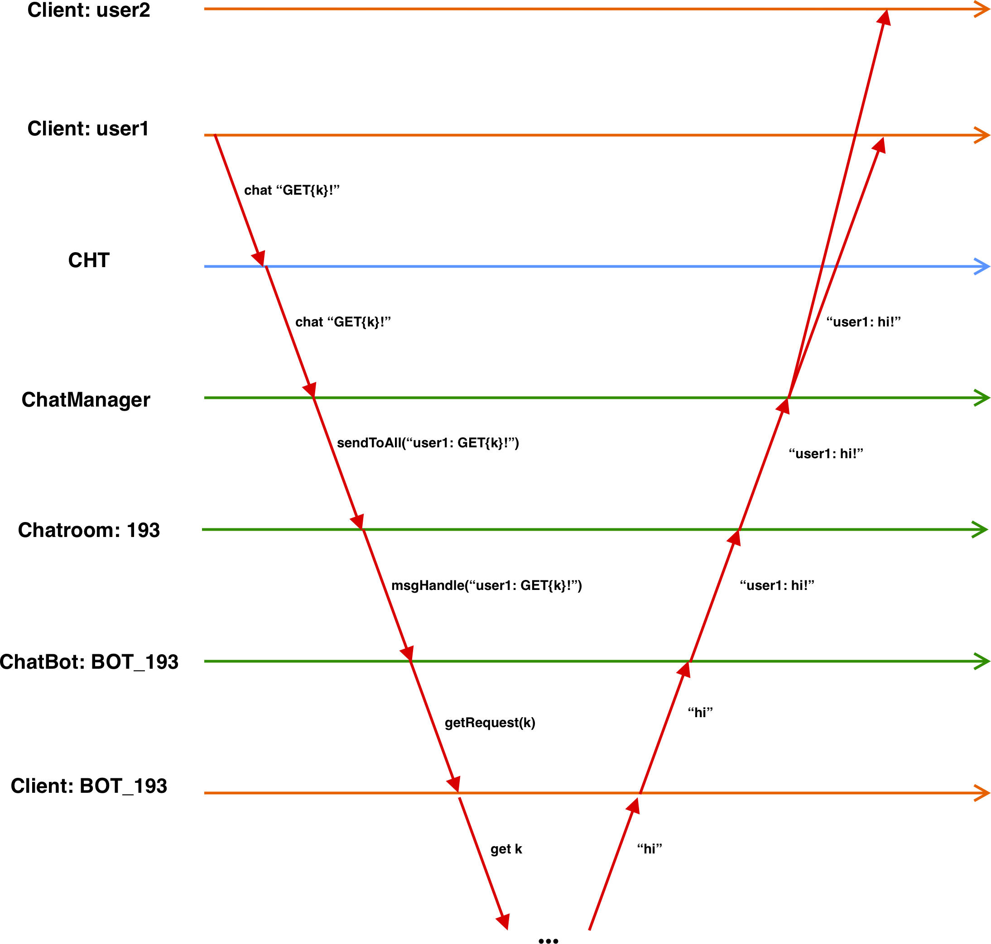
III. First Glance to our Extension – Group Chat II. Execution of the Workflow

Slide 7
IV. Implementation
I. Chat System
ChatManager
ChatRoom
ChatBot
TODO→Graphic for chatsystem

Slide 8
IV. Implementation
II. New Commands for the Group Chat
Commands | Functionalities
PUT <key> <value> | Stores the given value and allows future access to it through the provided key
PUT <key> | Deletes the value assigned to the given key
GET{key} | Inserts the value assigned to the given key into the message
WSP <user1>, <user2>, … , <userN> | Sends a whisper to the users provided by the client
QUIT | Leaves the chat session.
ACTIVE | Returns a list of all users in the chatroom
HELP | Displays the help text

Slide 9
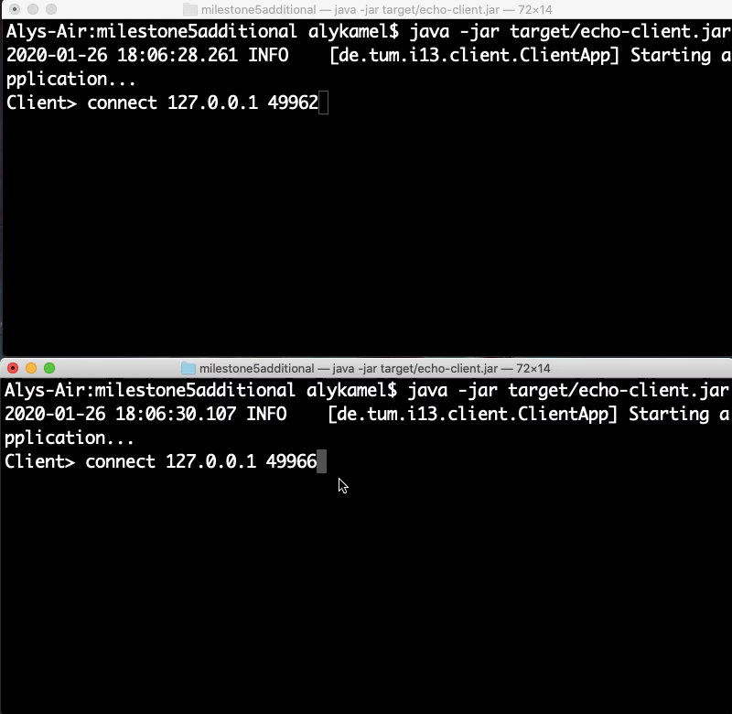
V. Demonstration

Slide 10
VI. Performance
I. Experimental setup
Our goal was to compare different levels of chat frequencies
Variables:
M = Number of chatmessages
D = Number of database operations e.g. put, get, delete
M/D = chatmessage per database operation

Slide 11
VI. Performance
II. Graph 1
0 M/D
1 M/D
10 M/D
100 M/D
1000 M/D

Slide 12
VII. Conclusion
I. Pros and Cons
Pros
Good for short msg
Acces to database in chat
Arg 3
Cons
Many people need better overview
Arg2
Arg3
No pictures etc., just words

Slide 13
VII. Conclusion
II. Recommendation of the extension
The extension should or shouldn‘t be used for chat heavy systems because its holds/loses performance after a critical amount of messages/database operation
Then the client should consider to use a third party software
for the communication

Slide 14
THANK YOU FOR YOUR ATTENTION!

Slide 15
VIII. References
[1] Keshav, S. (2007). How to read a paper. ACM SIGCOMM Computer Communication Review, 37(3), 83.
[2] Levin et al. (2012). Logically centralized?: state distribution trade-offs in software defined networks. In Proceedings of the first workshop on Hot topics in software defined networks - HotSDN ’12 (p. 1). Workshop/conference venue

Slide 16
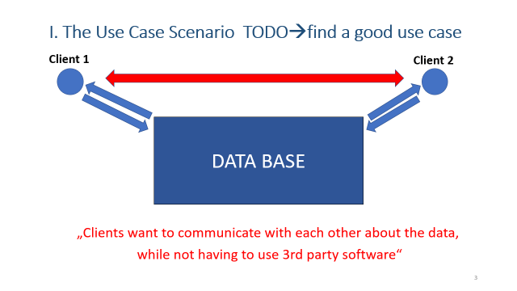
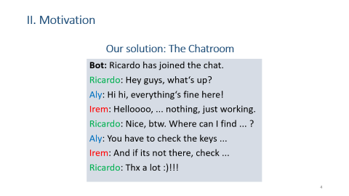
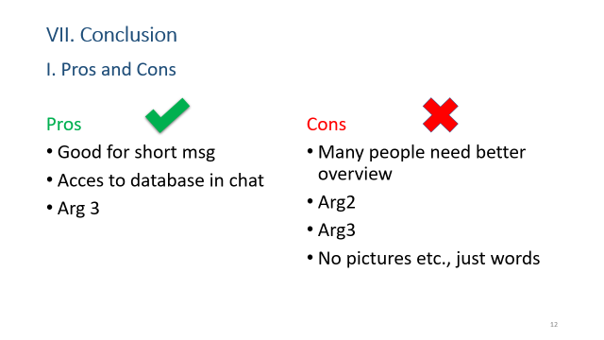
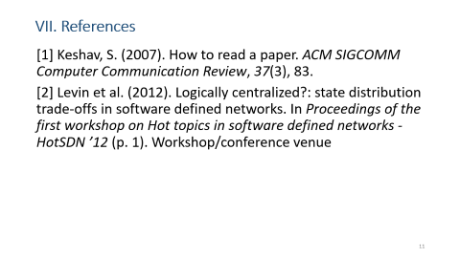
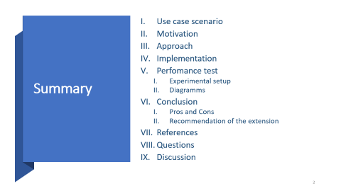
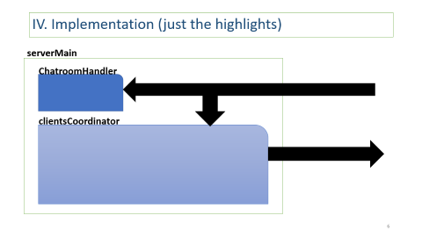
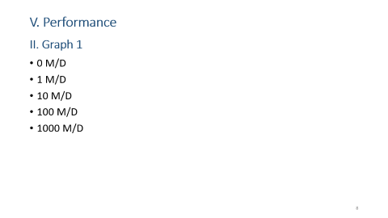
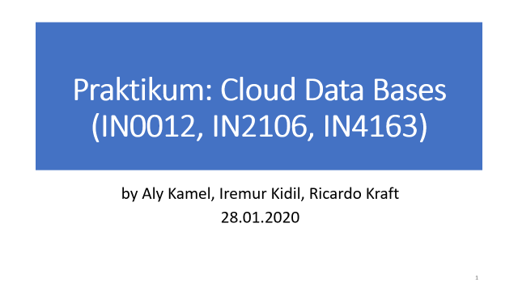
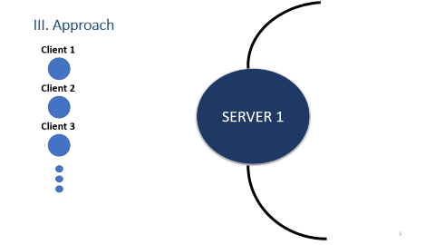
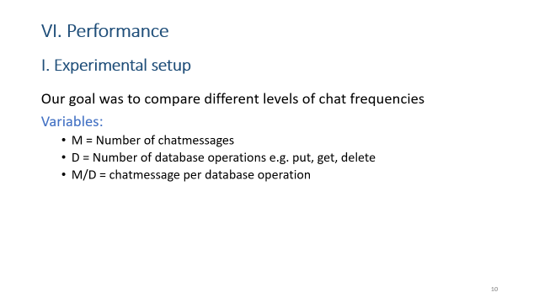
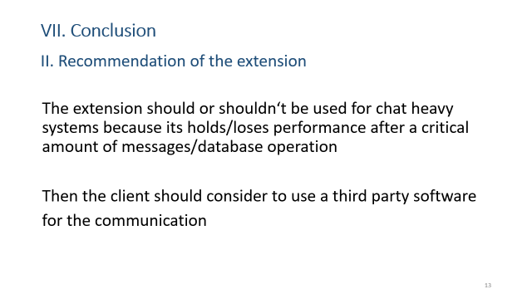
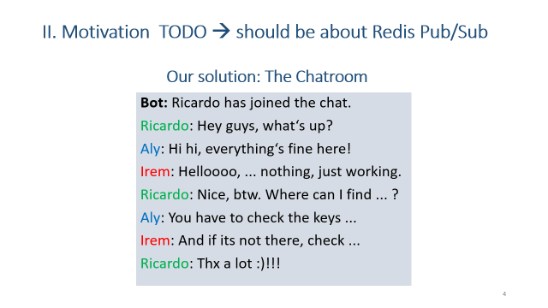

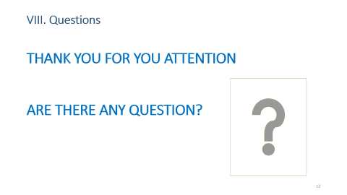
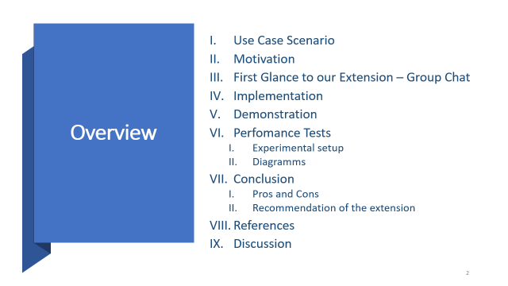
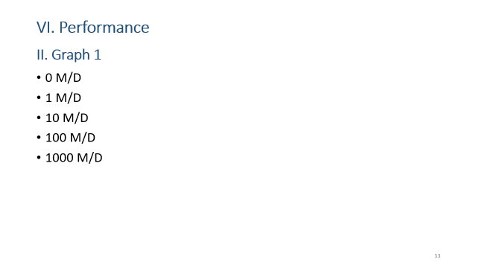

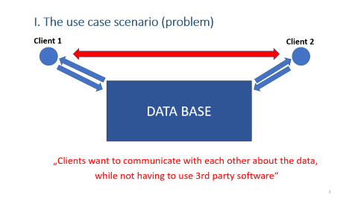
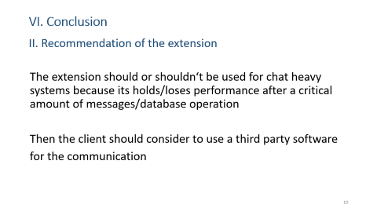
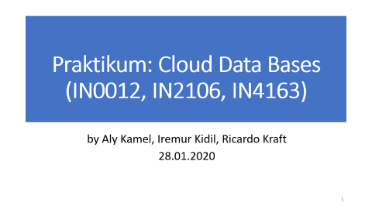

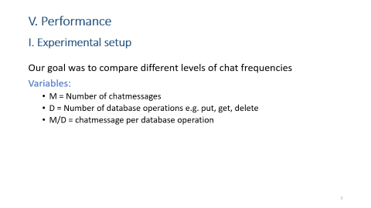

IX. Discussion

